Slide 1
Linear Regression for Machine Learning
Akshita Sharma

Slide 2

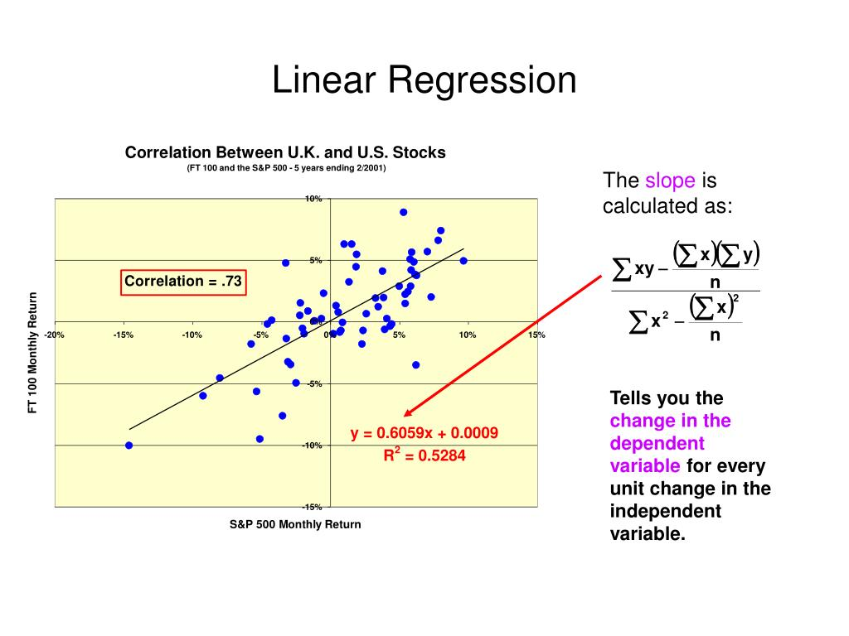
What Is linear regression ?
Linear regression is one of the simplest and most commonly used data analysis and predictive modelling techniques. The linear regression aims to find an equation for a continuous response variable known as Y which will be a function of one or more variables (X).

Slide 3

Isn’t Linear Regression from Statistics?
Machine learning, more specifically the field of predictive modeling is primarily concerned with minimizing the error of a model or making the most accurate predictions possible, at the expense of explainability. In applied machine learning we will borrow, reuse and steal algorithms from many different fields, including statistics and use them towards these ends.

Slide 4

Types of linear regression
Linear regression is a linear model
A model prepared this way as Ordinary Least Squares Linear Regression or just Least Squares Regression.

Slide 5
Linear Regression Model Representation
•For example, in a simple regression problem (a single x and a single y), the form of the model would be:
•y = B0 + B1*x
•In higher dimensions when we have more than one input (x), the line is called a plane or a hyper-plane. The representation therefore is the form of the equation and the specific values used for the coefficients (e.g. B0 and B1 in the above example).

Slide 6
Linear Regression Learning the Model
•Simple Linear Regression
• Ordinary Least Squares
•Gradient Descent
•Regularization

Slide 7
1. Simple Linear Regression
•With simple linear regression when we have a single input, we can use statistics to estimate the coefficients.

Slide 8
2. Ordinary Least Squares
•The Ordinary Least Squares procedure seeks to minimize the sum of the squared residuals. This means that given a regression line through the data we calculate the distance from each data point to the regression line, square it, and sum all of the squared errors together. This is the quantity that ordinary least squares seeks to minimize.

Slide 9
3. Gradient Descent
•This operation is called Gradient Descent and works by starting with random values for each coefficient. The sum of the squared errors are calculated for each pair of input and output values. A learning rate is used as a scale factor and the coefficients are updated in the direction towards minimizing the error. The process is repeated until a minimum sum squared error is achieved or no further improvement is possible.

Slide 10
4. Regularization
•Two popular examples of regularization procedures for linear regression are:
•Lasso Regression: where Ordinary Least Squares is modified to also minimize the absolute sum of the coefficients (called L1 regularization).
•Ridge Regression: where Ordinary Least Squares is modified to also minimize the squared absolute sum of the coefficients (called L2 regularization).

Slide 11
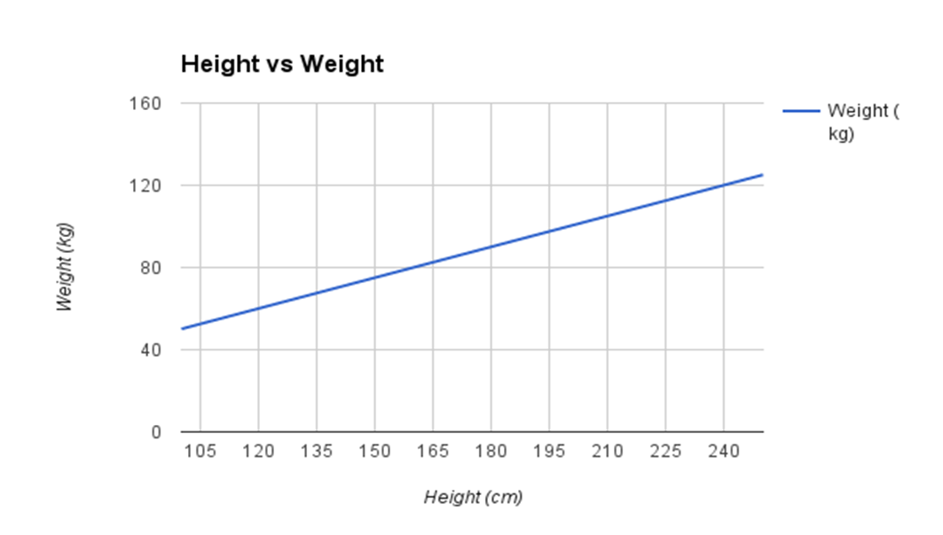
Making Predictions with Linear Regression
•Let’s make this concrete with an example. Imagine we are predicting weight (y) from height (x). Our linear regression model representation for this problem would be:
•y = B0 + B1 * x1
or
•weight =B0 +B1 * height
•weight = 0.1 + 0.5 * 182
•weight = 91.1

Slide 12
Preparing Data For Linear Regression
Linear Assumption
Remove Noise
Remove Collinearity
Gaussian Distributions
Rescale Inputs

Slide 13
Let's jump into the hands-on session
Google Collab

Slide 14
Summary / Topics covered in today's session
Introduction to Python
Installing Python
Python Basics
Execution Architecture Basics
Web-Scrapper using Python
Machine Learning
Linear Regression Hands-on with Python

